Slide 1

Software Foundations in JAVA (JSF)
Lesson 3 Processes & Threads
Peter Boots
p.boots@fontys.nl
Erik van der Schriek
e.vanderschriek@fontys.nl

Slide 2
Overview
Processes
Threads
Assignment week3
Notes:
Next: what is an OS

Slide 3
Process
Process – a program in execution; process execution must progress in sequential fashion
A process includes:
  Program counter (current location in code)
  Content of processor's registers
  Stack (parameters, return address, local variables)
  Heap (dynamically allocated memory)
  Data section (global variables)
  Text section (program code)
Notes:
Next: what does it look like in memory?
A process is more than the program code, which is also known as the text section. A process also includes the current activity, represented by the value of the program counter and the contents of the processor's registers. A process also includes the process stack to store temporary data (such as funtion parameters, return addresses, and local variables), and a data section, which contains global variables. A process may also include a heap, which is memory that is dynamically allocated during process run time. The structure of a process in memory is shown in the next slide.
Silberschatz et al., Operating System Concepts, 8th Edition, page 102.

Slide 4
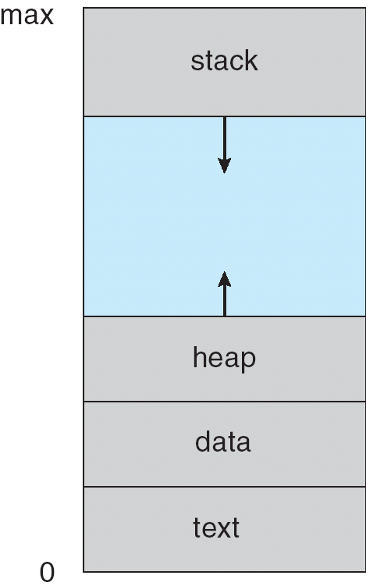
Process in Memory
Compiled Program Code
Notes:
Problem: are all processes running at the same time? -> Next: Process States

Slide 5
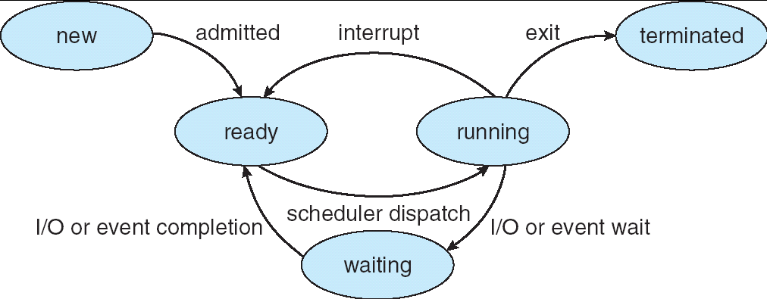
Diagram of Process State
See: procflowa.gif
Notes:
Waiting = blocked and/or suspended (swapped out)
Problem: What is needed in every state? -> Next: PCB

Slide 6
Process State
As a process executes, it changes state
  new: The process is being created
  running: Instructions are being executed
  waiting: The process is waiting for some event to occur
  ready: The process is waiting to be assigned to a processor
  terminated: The process has finished execution

Slide 7
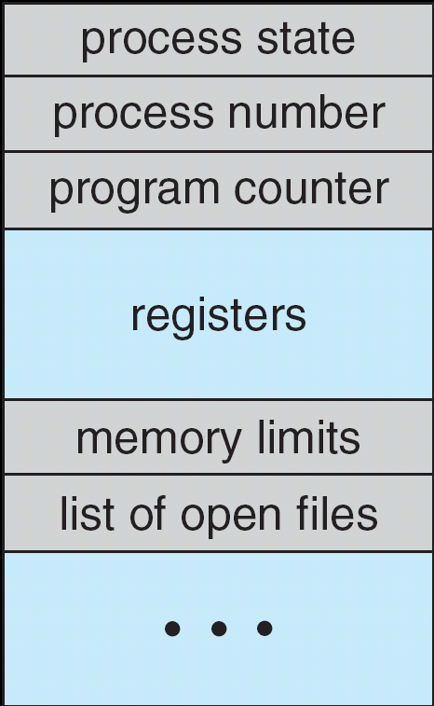
Process Control Block (PCB)
Notes:
Information associated with each process / administration per process
Process state
Program counter
CPU registers
CPU scheduling information
Memory-management information
Accounting information
I/O status information
Silberschatz et al., Operating System Concepts, 8th Edition, page 104.
Problem: what actions take place during switch of processes? -> Next: context switch

Slide 8
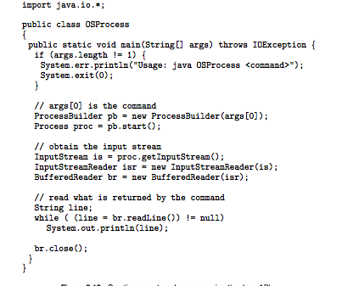
Process Creation in Java
Notes:
This is also possible with Runtime Object in JAVA.
Laten zien in NetBeans in VM
Next -> termination of process

Slide 9
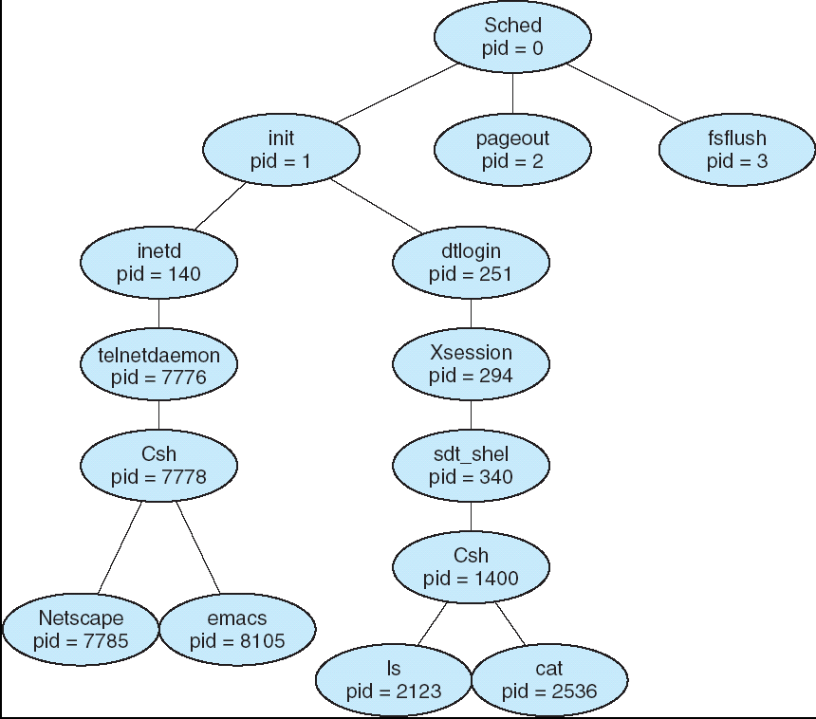
Process tree
pid = process identifier
Commando's: ps, pstree, top
Notes:
(child) Processes are created from existing (parent) processes. Considerations for the OS are:
Resource sharing
Parent and children share all resources
Children share subset of parent’s resources
Parent and child share no resources
Execution
Parent and children execute concurrently
Parent waits until children terminate
Address space
Child duplicate of parent
Child has a program loaded into it
Silberschatz et al., Operating System Concepts, 8th Edition, page 110,111.

Slide 10
Thread
Thread – the smallest sequence of programmed instructions that can be managed independently by a scheduler
Thread versus process:
  A thread is a component of a process
  Multiple threads can exist within one process
  Threads may execute concurrently and share resources such as memory, I/O
  Different processes do not share these resources
Notes:
Next: what does it look like in memory?
A process is more than the program code, which is also known as the text section. A process also includes the current activity, represented by the value of the program counter and the contents of the processor's registers. A process also includes the process stack to store temporary data (such as funtion parameters, return addresses, and local variables), and a data section, which contains global variables. A process may also include a heap, which is memory that is dynamically allocated during process run time. The structure of a process in memory is shown in the next slide.
Silberschatz et al., Operating System Concepts, 8th Edition, page 102.

Slide 11
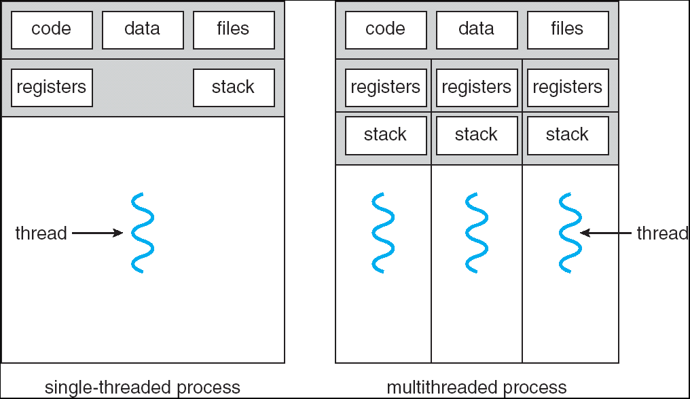
Single- and Multi-threaded Processes
Notes:
Sharing of code, data, files.
Next: benefits
Silberschatz et al., Operating System Concepts, 8th Edition, page 154.

Slide 12
Java Threads
Java threads can be used as follows:
  Make a class that implements Runnable interface
    class MR implements Runnable{
    public void run(){ ...... };
    }
  Instantiate that class:
    MR r1 = new MR();
  Create a thread that will execute the Runnable:
    Thread thrd = new Thread(r1);
  Start that thread (it will execute the run method):
    thrd.start();
Notes:
Things to know:
Almost all JVM’s don’t support interprocess communication (mainly for security reasons. Every process uses one JVM). So concurrency needs to be achieved only with threads.
JAVA has support for concurrency in the language itself + has a very extensive library for thread management and synchronisation.
Time to create a thread! -> netbeans
Next: thread states

Slide 13
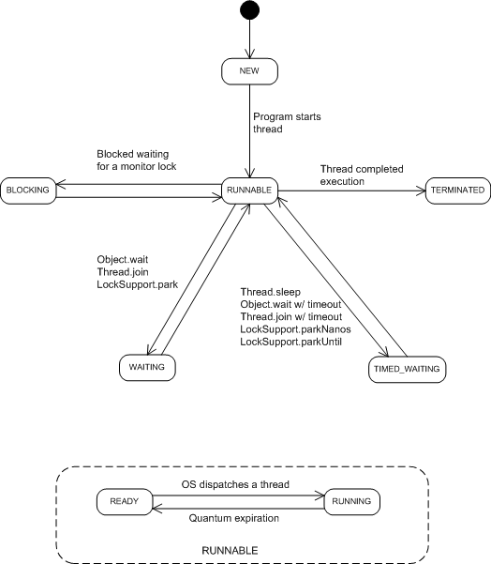
Java Thread States
Notes:
Blocked State can be:
Blocked: waiting for a lock
Waiting: waiting for a notification
Timed waiting: waiting for timeout or notification
Difference between blocked and (timed) waiting is not significant from programmers perspective.

Slide 14
Threading Issues
Mapping user threads on system threads
Scheduler activations
Thread cancellation

Slide 15
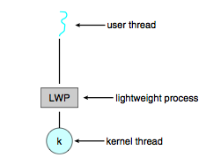
User/system thread mapping
Modern OS’s actually schedule system threads instead of processes.
User threads (JAVA) must be mapped on system threads. (1:1, N:1, N:M, M<=N)
Done by using LightWeightProcesses (LWP), amount is determined by OS
Notes:
Many-to-one (N:1):
Many user-level threads are mapped to one kernel thread.
One-to-one (1:1):
Each user thread is mapped to kernel thread. Creating a user thread requires creation of a kernel thread.
Many-to-many (N:M)
Multiplexes many user-level threads to a smaller or equal number of kernel threads.
Silberschatz et al., Operating System Concepts, 8th Edition, page 157, 158.

Slide 16
Thread scheduling
Scheduler is concerned with: CPU usage, throughput, turnaround time, response time, fairness. Often conflicting
Algorithms: FCFS, SJF, Round Robin
See http://en.wikipedia.org/wiki/Scheduling_(computing)

Slide 17


Slide 18
First-Come, First-Served (FCFS) Scheduling
Process Burst Time
P₁ 24
P₂ 3
P₃ 3
Suppose that the processes arrive at time 0 in the order: P₁ , P₂ , P₃
The Gantt Chart for the schedule is:
Waiting time for P₁ = 0; P₂ = 24; P₃ = 27
Average waiting time: (0 + 24 + 27)/3 = 17
P₁
P₂
P₃
0
24
27
30
Notes:
Voordeel: scheduler zelf is simpel, dus snel
Dit is non-preemptive!
Is volgorde van belang?=>next

Slide 19
FCFS Scheduling (Cont.)
Suppose that the processes arrive at time 0 in the order
P₂ , P₃ , P₁
The Gantt chart for the schedule is then:
Waiting time for P₁ = 6; P₂ = 0; P₃ = 3
Average waiting time: (6 + 0 + 3)/3 = 3
Much better than previous case
Convoy effect short process behind long process
P₂
P₃
P₁
0
3
6
30
Notes:
Altijd korte processen eerst? => SJF

Slide 20
Shortest-Job-First (SJF) Scheduling
Associate with each process the length of its next CPU burst.
Use these lengths to schedule the process with the shortest time
Two schemes:
  Non-preemptive – once CPU given to the process, the OS can not take it back until the process completes its CPU burst
  Preemptive – if a new process arrives with CPU burst length less than remaining time of current executing process, the OS takes CPU back. This scheme is known as Shortest-Remaining-Time-First (SRTF)
SJF is optimal – gives minimum average waiting time for a given set of processes
Notes:
SJF is optimaal voor minimale wachttijd.
Nadeel:
burstgrootte is niet op voorhand bekend (schatten dmv exponentieel gemiddelde van tijdsduur vorige bursts).
Starvation is mogelijk

Slide 21
Example of Preemptive SJF
Process Arrival Time Burst Time
P₁ 0.0 7
P₂ 2.0 4
P₃ 4.0 1
P₄ 5.0 4
SJF (preemptive)
Average waiting time = (9 + 1 + 0 +2)/4 = 3
P₁
P₂
P₃
P₂
P₄
P₁
0
2
4
5
7
11
16
Notes:
Eigenlijk geef je elk proces een prioriteit: Next: priority scheduling

Slide 22
Round Robin (RR)
Each process gets a small unit of CPU time (time quantum, time slice), usually 10-100 milliseconds.
After this time has elapsed, the process is preempted and added to the end of the ready queue.
If there are n processes in the ready queue and the time quantum is q, then each process gets 1/n of the CPU time in chunks of at most q time units at once.
No process waits more than (n-1)q time units.
Performance
  q large −> FIFO
  q small −> Context switch overhead becomes an issue (q must be large with respect to context switch)
Notes:
Let op time quantum

Slide 23
Example of RR with Time Quantum = 20
Process Burst Time
P₁ 53
P₂ 17
P₃ 68
P₄ 24
The Gantt chart is:
Typically, higher average turnaround than SJF, but better response
P₁
P₂
P₃
P₄
P₁
P₃
P₄
P₁
P₃
P₃
0
20
37
57
77
97
117
121
134
154
162

Slide 24
Thread Cancellation
Terminating a thread before it has finished its complete code
Two general approaches:
  Asynchronous cancellation terminates the target thread immediately, no matter what it is doing
  Deferred cancellation the target thread checks periodically if it should stop, and if so, terminates itself in a controlled way

Slide 25
Asynchronous Cancellation
A thread can be stopped like this, but it is not advised:
  thrd.start();
  ….
  thrd.stop(); ← Asynchronous cancellation
Dangerous, because the thread can not finish what it was doing

Slide 26

Deferred Cancellation
Notes:
You can only request threads by means of an interrupt. You cannot safely force termination of a thread.

Slide 27
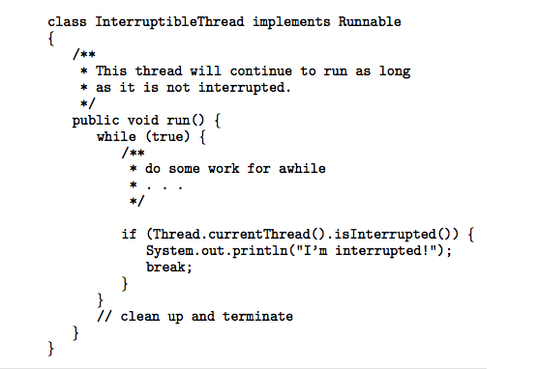
Deferred Cancellation
Thread checks its interrupt status:
Notes:
But what if thread is sleeping? -> thread is awoken by InterruptedException -> code default runnable (Core Java 8th ed. Page 729)

Slide 28
Default Runnable
public class DefaultRunnable implements Runnable {
private boolean moreWork = true;
public void run() {
try {
while(!Thread.currentThread().isInterrupted() && moreWork){
// do work
}
}
catch(InterruptedException e) {
// thread interrupted during 'sleep' or 'wait'
}
finally {
// cleanup, if required
}
}
Notes:
But what if thread is sleeping? -> thread is awoken by InterruptedException -> Next: code default runnable (from core java 8th ed. Page729)
Problem: also thread creation takes time. Not wanted on webserver -> Next: threadpools

Slide 29
Assignment
See Canvas

Slide 30
Homework
Reference
  JAVA: http://www.javamex.com/tutorials/threads/index.shtml
  Linux: http://linux-training.be/files/books/LinuxFun.pdf Ch18 + Ch 19
  [BOOK] Core JAVA - volume 1:
    Chapter 14 (MultiThreading): up to 'Thread properties'
Suggested study / background information
  http://www.iu.hio.no/~mark/os/os.html
  http://physinfo.ulb.ac.be/cit_courseware/opsys/ostart.htm

Slide 31
End of Chapter

